Slide 1
Miss DePalo’s 5th Grade Class
Session 2, December 2nd 2021
Hosts:
Enzo’s Mum – Coordinator

Slide 2
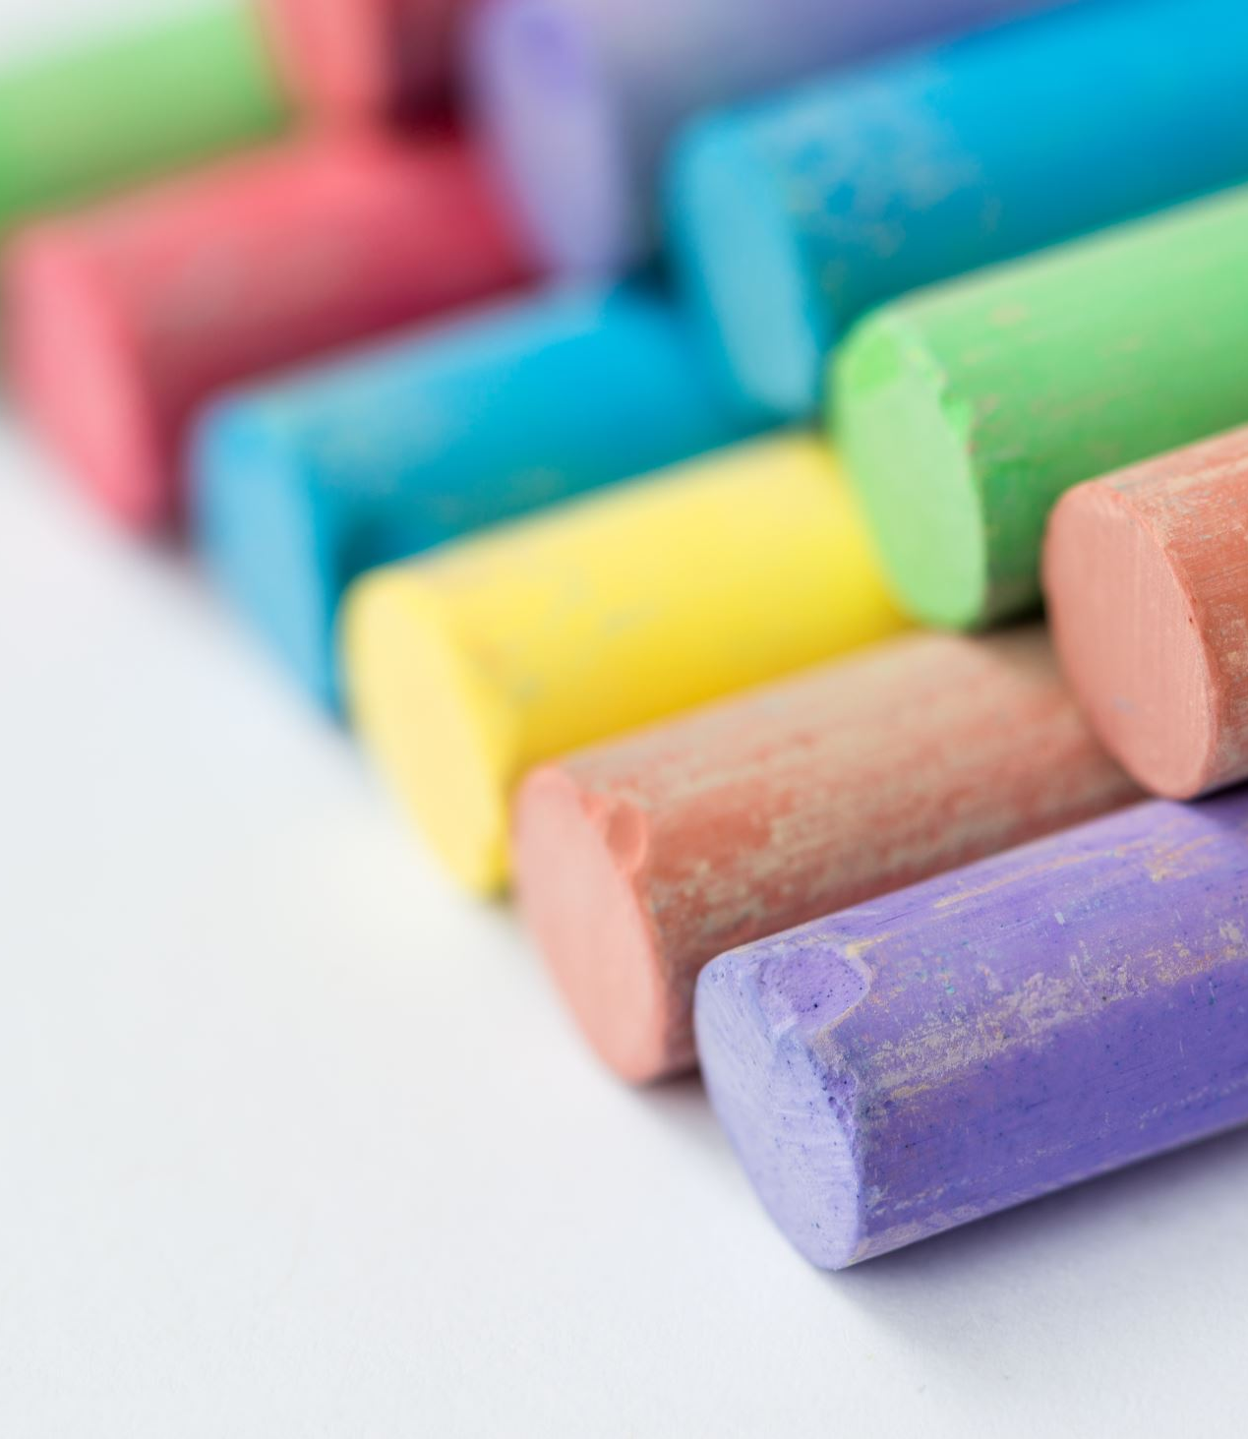
What’s Meet the Masters?
An art appreciation program to introduce children to the world of art
A way to cultivate interest in art history in our youth
To freely express the impact art has on each individual
A break from the routine to learn something new about famous artists
An opportunity to have FUN through ART!

Slide 3
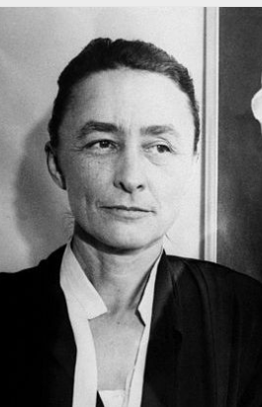
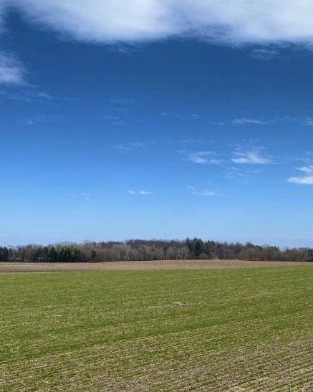
Georgia O’Keefe
(1887-1986)

Slide 4
ABOUT O’KEEFE’S LIFE
Georgia O’Keefe was an American artist born in 1887, in Sun Prairie, Wisconsin. She spent her childhood on a large farm. She always had a love for nature and land.
She knew she wanted to be an artist as early as 10 years old and studied at the Chicago Art Institute and later at the Art Students League in New York
She worked as an artist in Chicago and as an art teacher in Texas and South Carolina.
A famous photographer, Alfred Stieglitz, recognized her work and decided to show her art in his gallery. They later married.

Slide 5
“Yellow Cactus”
?
What do you think this painting is about?

Slide 6
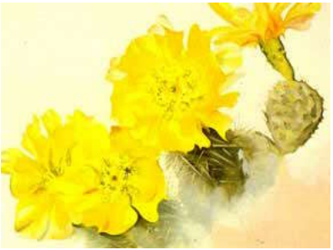
Yellow Cactus
20th Century American, 1940, Oil on canvas
Maier Museum of Art, Lynchburg, Virginia
Decorative pattern that moves diagonally on canvas

Slide 7
“Ranchos Church”
?
What do you expect to see?

Slide 8
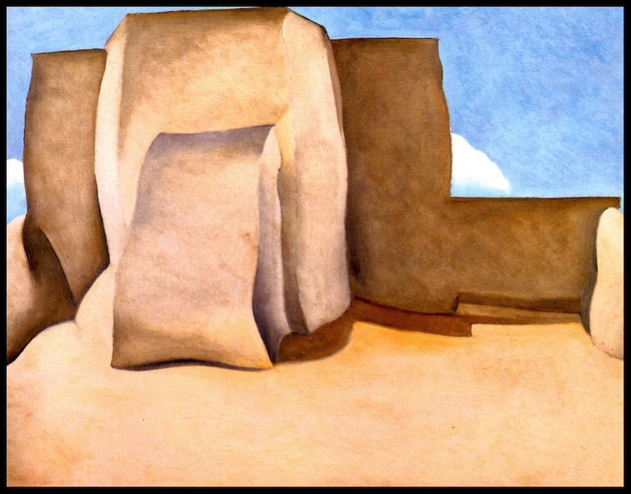
Ranchos Church
20th Century American, 1929, Oil on canvas
Philips Collection, Washington, DC
Combines abstractions with precise realism

Slide 9
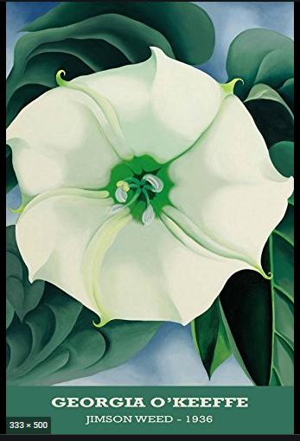

Slide 10
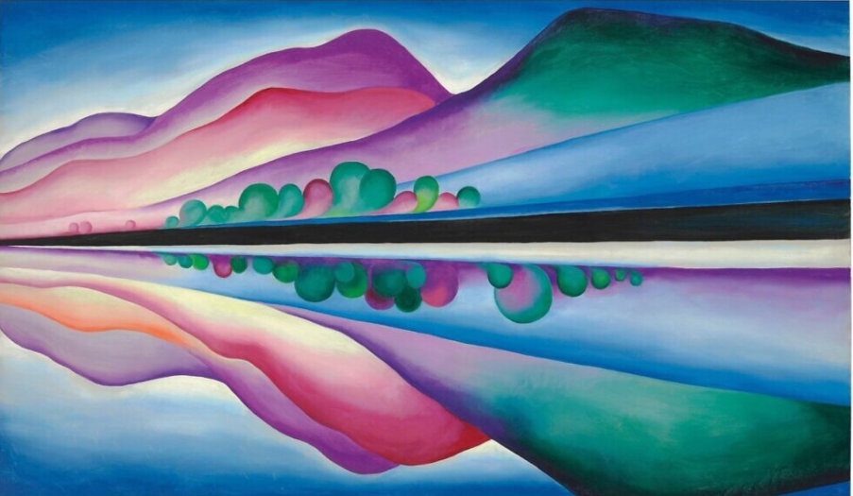
Lake George Reflection

Slide 11
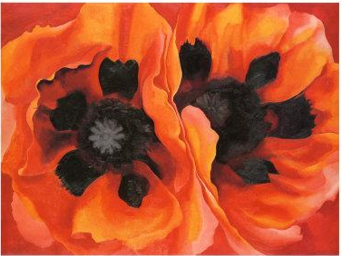
Oriental Poppies

Slide 12
Let’s talk about these paintings
What do these paintings have in common?
What details do you see in these pictures?
What emotion do you feel when you look at these pieces?
What do these pieces say about the artist?

Slide 13
Anonymous

Slide 14
“Mississippi Home”
?
What do you expect to see in this painting?

Slide 15
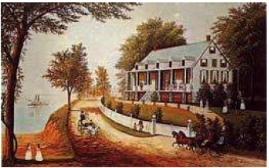
Mississippi Home
American, circa 1865, unknown medium
Garbisch Collection
A mansion to replace the original cabin

Slide 16
Let’s talk about these paintings
Between 1820 – 1860 the most popular architectural style in mansions was Greek Revival. This style adapted the temples of Athens to the needs of the 19th century.
Describe the environment. What do the people see and hear? How do you know?
What was their means of transportation?
Are the pictures quiet or noisy? How can you tell?

Slide 17
Activity time

Slide 18
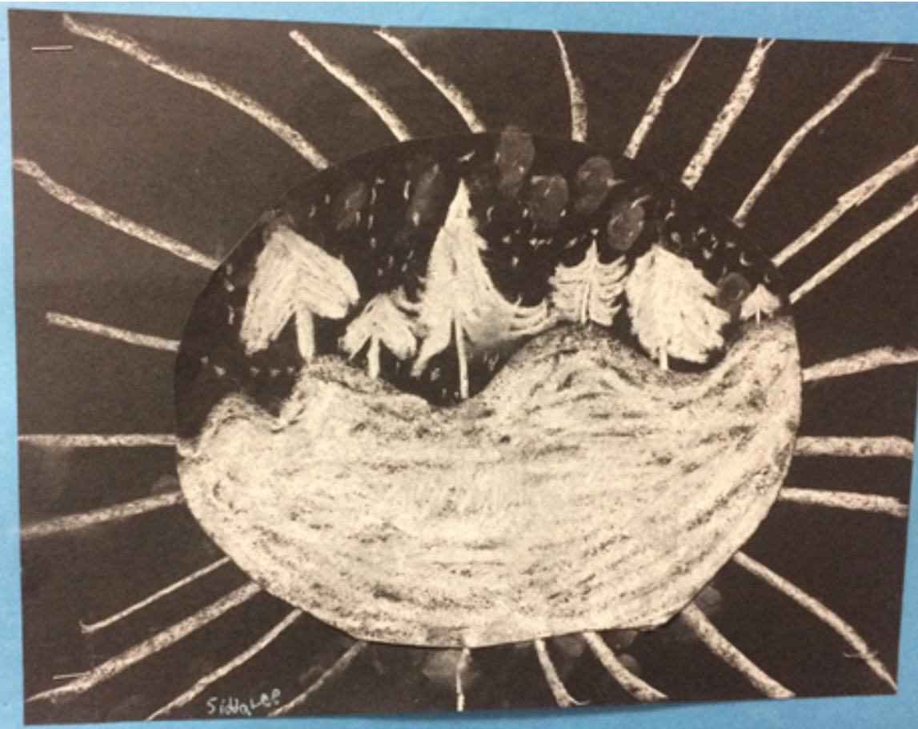
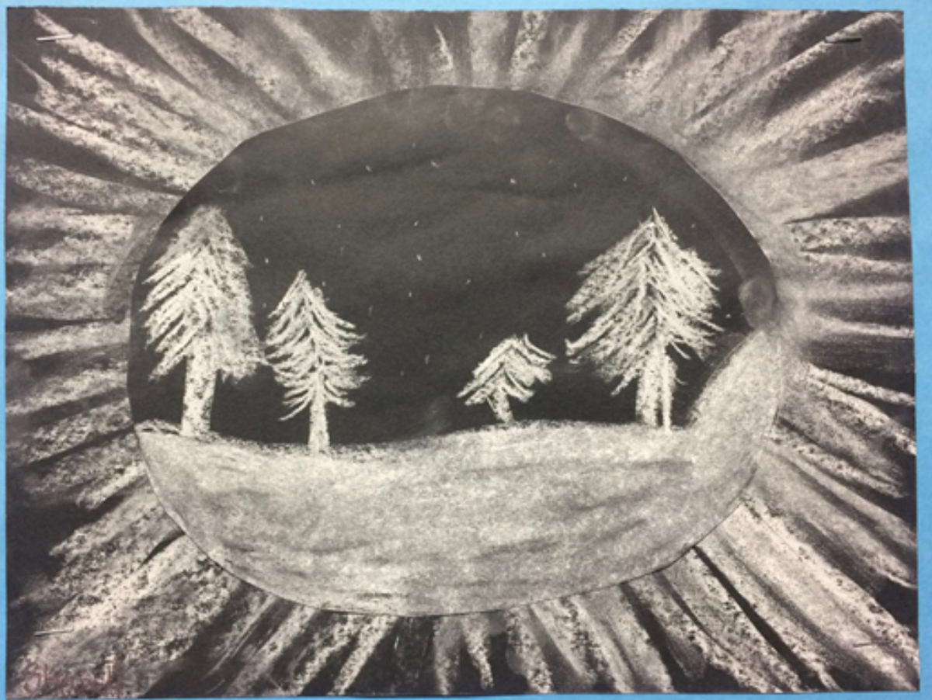
Inspiration

